Slide 1
Mitchell Boyle
T2A2 Marketplace Assignment

Slide 2
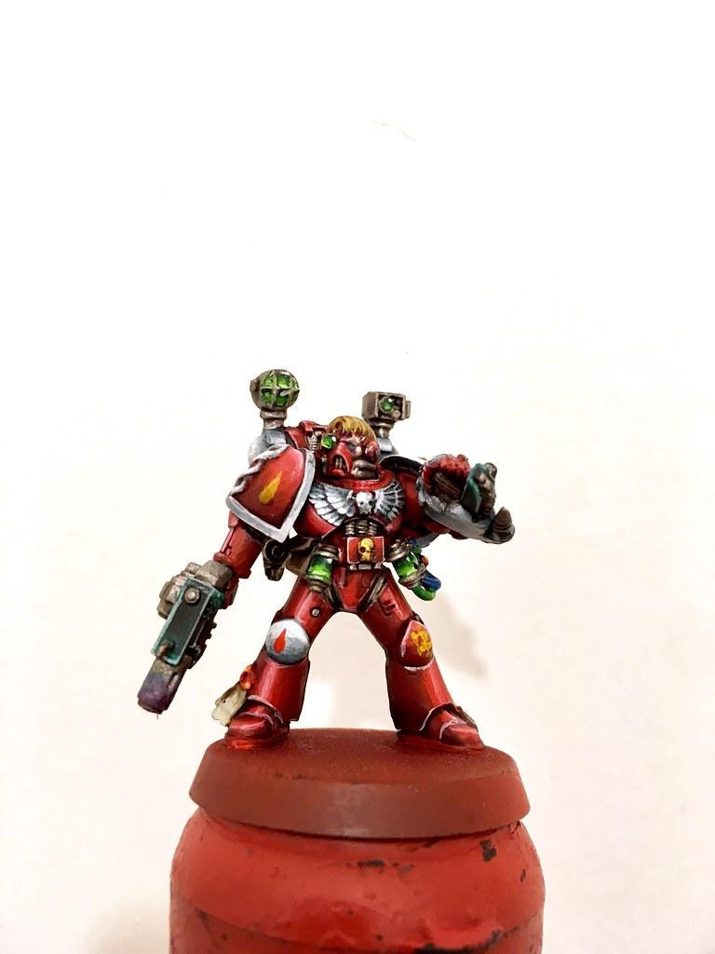
What is Painted Minis
Painted Minis is a website design to help users ensure their second hand miniatures end up in the hands of equally enthusiastic hobbyists.
Painted Minis focuses on Sci-Fi and Fantasy miniatures.

Slide 3
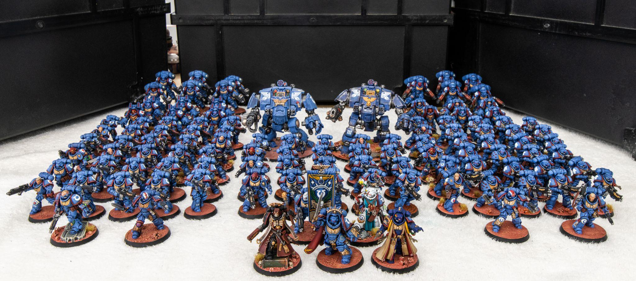
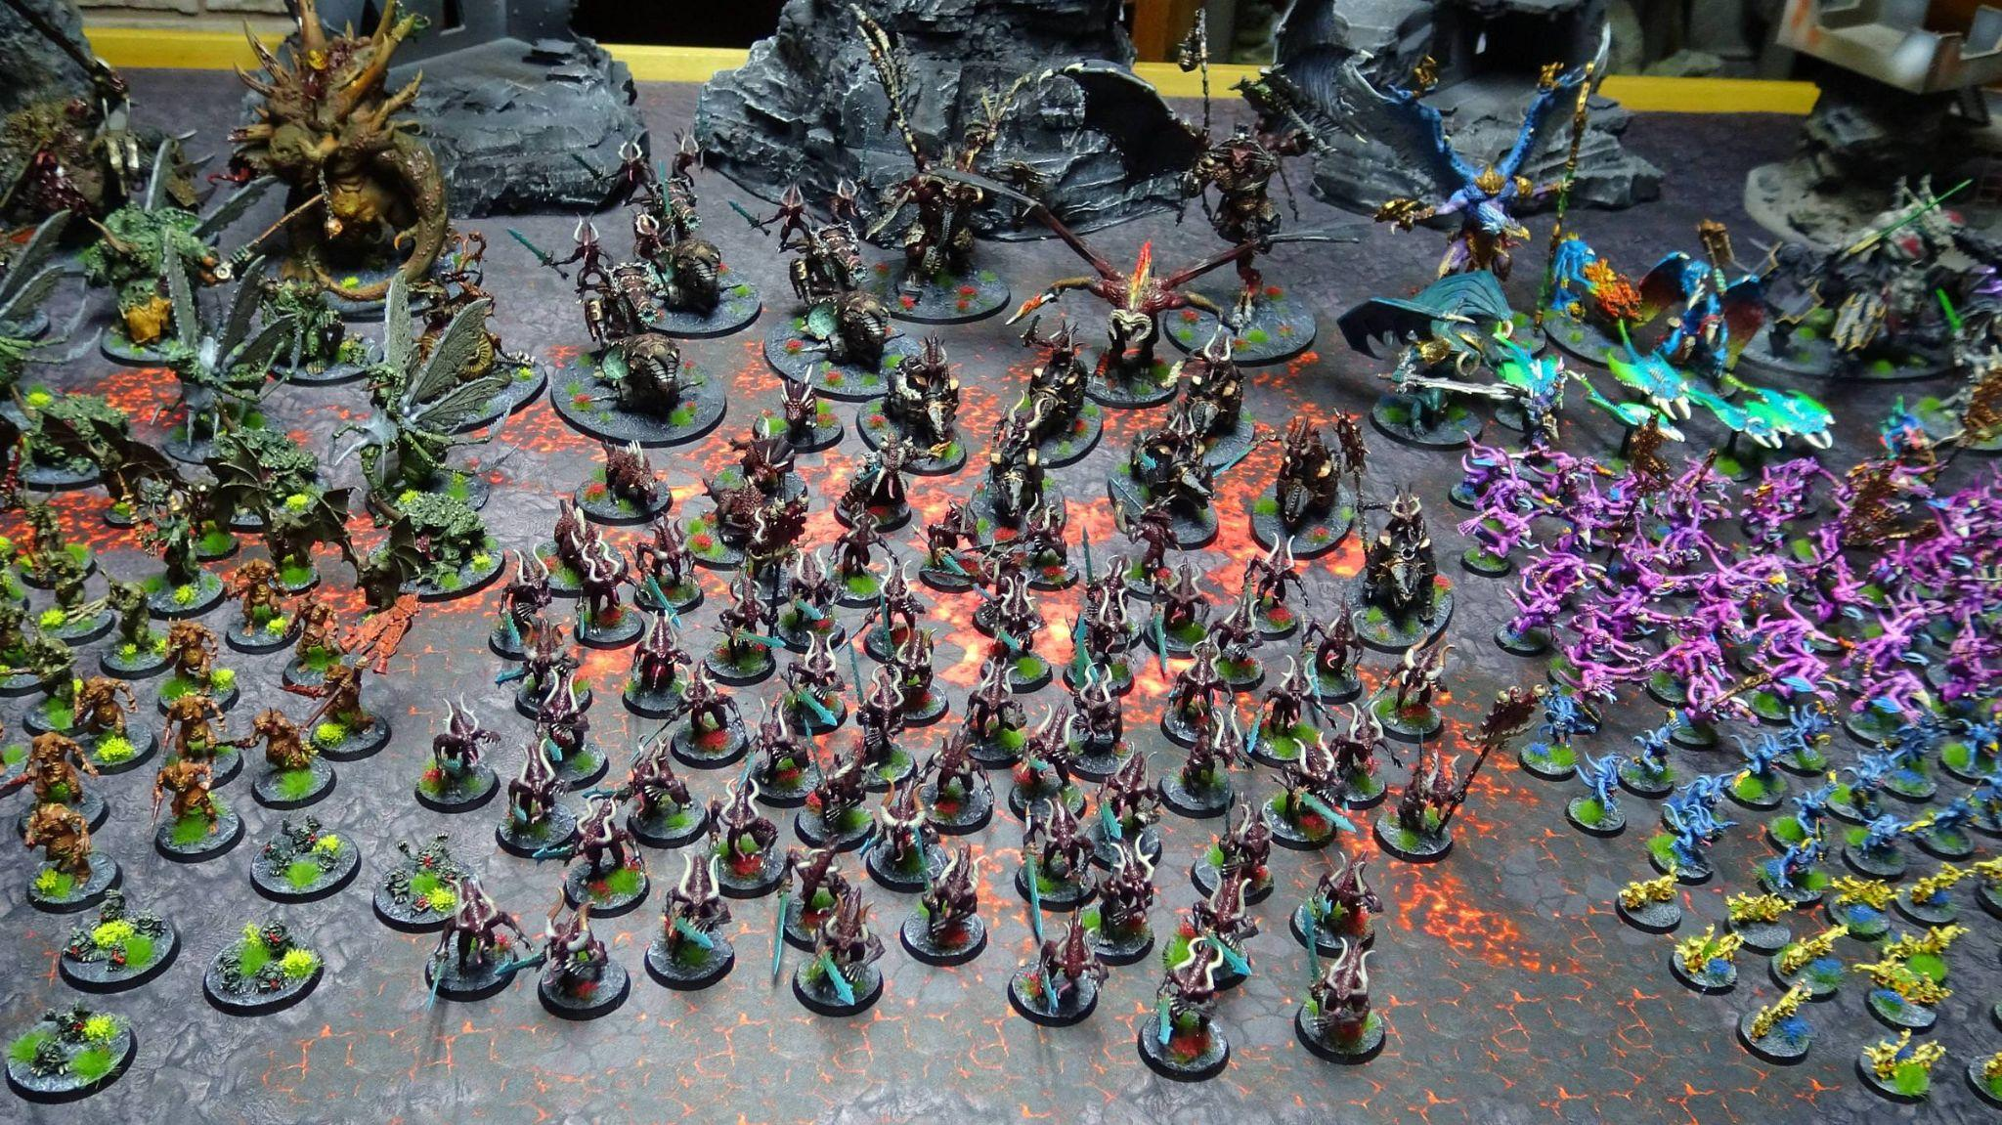
The purpose
Many people who are interested in tabletop RPGs & tabletop wargames can live very busy lives. This can lead to their limited time spent on the hobby focused on not only the pain stacking task of painting their miniatures. In games like Warhammer: 40,000 this issue is very prominent as a player may have upwards of 50 minis to paint.

Slide 4
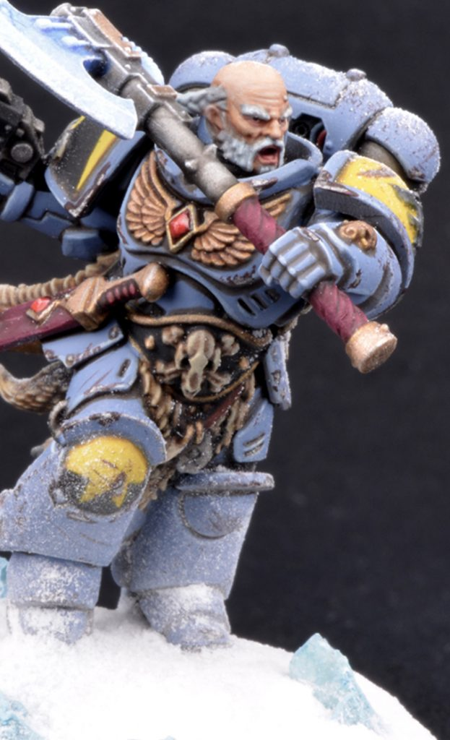
The purpose
Player can sometimes spend hours upon hours researching and learning painting techniques to ensure they can reach the level of quality they desire before they even touching a paint brush
This site aims to assist those who may not have the skills it takes, but also those who are looking to spend more time playing rather than painting.
This site also creates a great opportunity for the skilled painters within the community to showcase their skills.

Slide 5
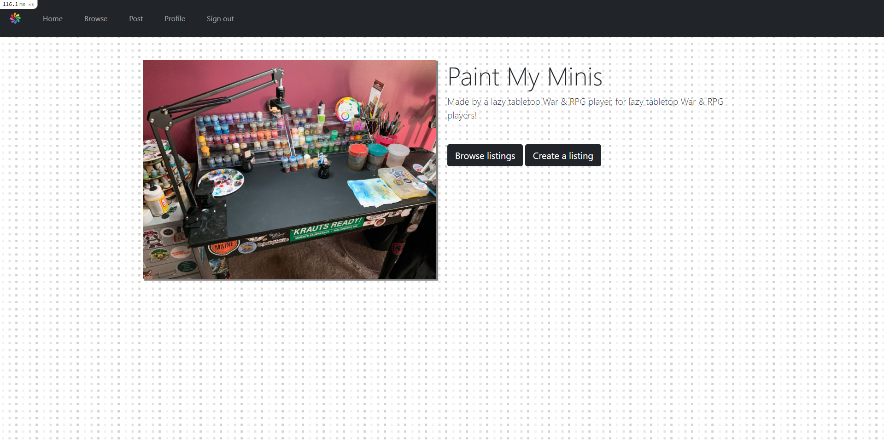
Walkthrough - Home
Upon creating an account, users will be prompted with two options. One to browse the currently available listing, and a second to post their own listing.

Slide 6
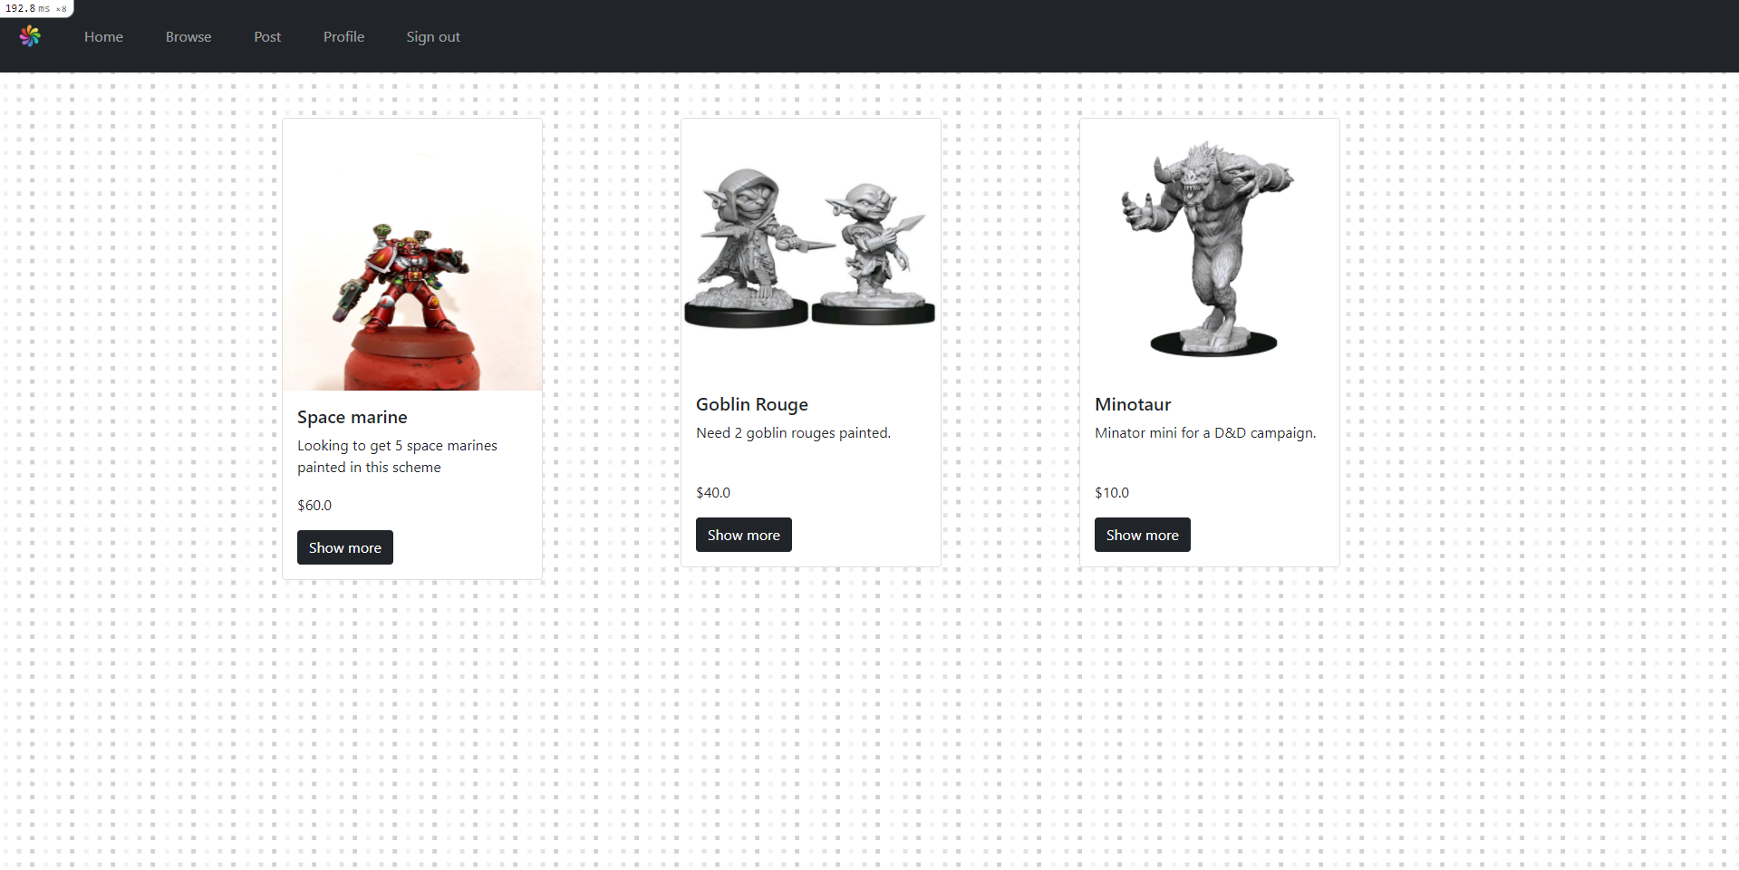
Walkthrough - Browse
A user looking to buy minis to add to their collection can view all available listings.

Slide 7
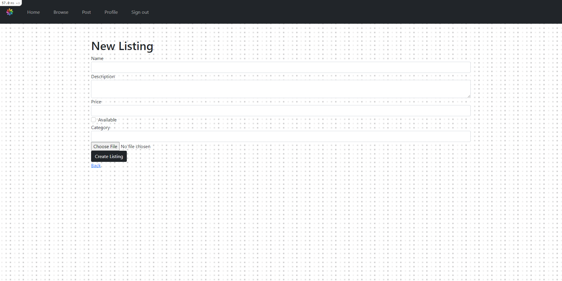
Walkthrough - Posting
A user looking to submit their own listing will be prompted with a form they are required to fill in.

Slide 8
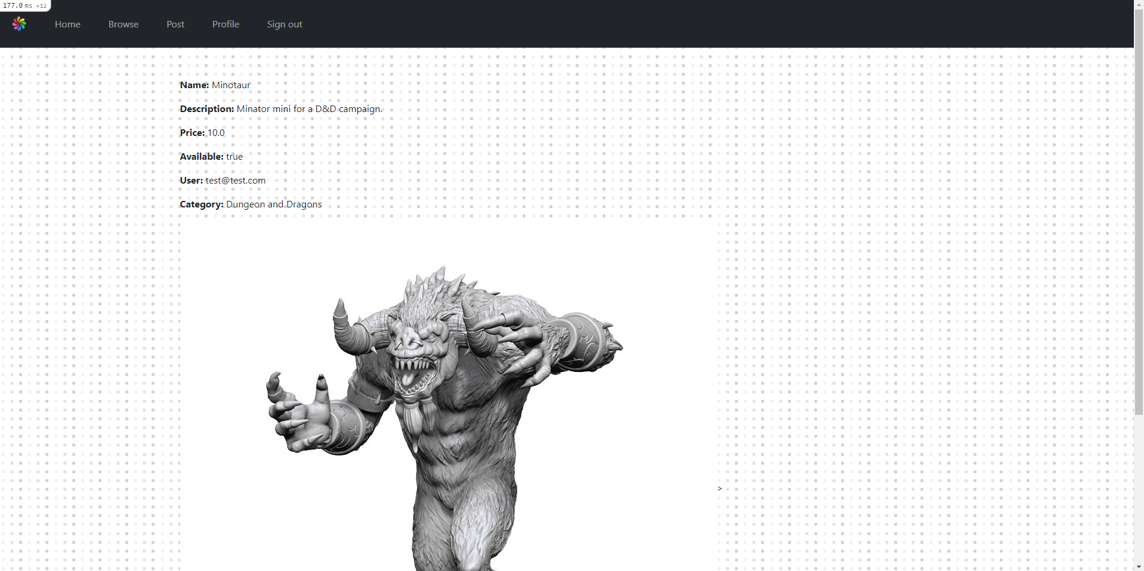
Walkthrough - Single listing
When a user looking to purchase another users listing they will be shown the information in detail. If interested the user may select the “Buy Now” option to complete the purchase.
*Still requires styling

Slide 9
Thank you for listening!
T2A2 Marketplace Assignment

